Slide 1
General Instructions
(Delete this page after preparing the presentation)
This is a broad general template to guide the investigator
The headings may be modified/added/deleted depending upon the type of the study
Lines in this colour are instructions to be followed. Delete them once the content is written
All relevant and important information specific for each research proposal should be included
Information presented here should match with that filled in the application form submitted to the IEC by mail and in paper
Presentation time is around 5 min
The presenter should be a part of the research team

Slide 2
Complete Title of the study
Principal Investigator
Guide
Co-Investigators

Slide 3
Background and Justification
Key statistics showing magnitude of problem
Gap in literature
Justification for conducting study
Local relevance

Slide 4
Aims and Objectives
Clearly defined aim
specific measurable objectives
Clearly identifiable variables

Slide 5
Methodology
Study Design
Type of study (cross-sectional/cohort/RCT/etc.)
Study setting
Study population
Study duration (Month–Year)

Slide 6
Sample Size
Formula used
Relevant article
Assumptions (p, q, d, power, effect size)- if applicable
Calculated sample size
Adjustment for non-response - if applicable
Final rounded sample size

Slide 7
Participant selection criteria
Inclusion criteria
Exclusion criteria

Slide 8
Study protocol in brief
Data collection method/ Intervention used/ etc

Slide 9
Data Analysis Plan
Statistical software
Descriptive statistics
Inferential tests
Significance level (p < 0.05)
Handling of missing data

Slide 10
Ethical concerns
Consent in English and Kannada
Participant information in English and Kannada
Confidentiality
Type of risk involved (Refer next slide)
Vulnerable population
Amount of time the participant is expected to spend for the research
Costs involved and Who will bear them
Storage of data, samples
Expected adverse events
Reporting and compensation for adverse events
CTRI

Slide 11
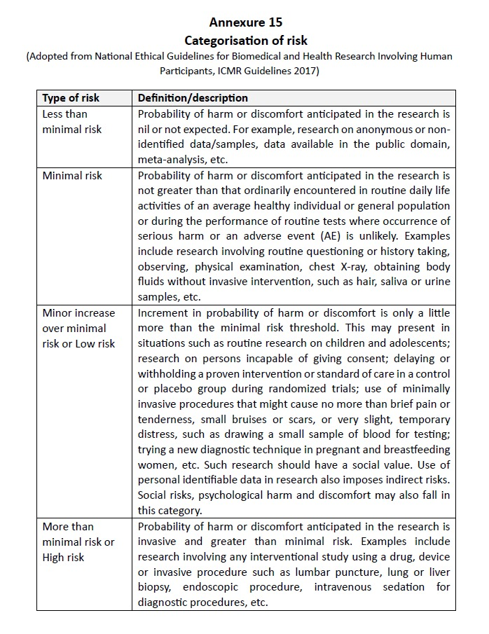
Risk Involved in conducting research

Slide 12
Consent form in English
Clear image of the document

Slide 13
Consent form Kannada
Clear image of the document

Slide 14
Participant information sheet English
Clear image of the document

Slide 15
Participant information sheet Kannada
Clear image of the document

Slide 16
Questionnaire in English
Clear image of the document

Slide 17
Questionnaire in kannada
Clear image of the document

Slide 18
References

